Slide 1

Understanding the Linkage between Humans and Agreements in Insight
Holly Sommers
Associate VP, Research Administration
Office of Sponsored Programs

Slide 2
Session Objectives
Understand Current Status of Insight Implementation
Identify differences between Compass/EPEX and Insight
Discuss linkage between Insight modules

Slide 3
Insight Implementation – Current Status
Initial Insight Implementation – September 2, 2025
Included Humans and Agreements
Agreements module includes 6 different “record types:”
  Proposals and Funded Agreements
  CDAs
  MTAs
  DUAs
  Unfunded/Miscellaneous
  External Activities (not use by OSP)
Agreements implemented with modified functionality related to Proposals and Funded Agreements

Slide 4
Insight Implementation – Current Status
Agreements Module, current functions:
  Replaces RAS “Intent to Submit” form for Proposals and Funded Agreements record type
  Used for management of certain pre-award functions, including JIT and tracking of contract negotiation
  Intake/management of all CDAs, MTAs, DUAs and Unfunded/Miscellaneous record types
  EPEX/Compass remain in use; will be further modified as part of Release 2 of Insight
Notes:
eCTS, eGTS and OTT intake systems have been discontinued

Slide 5
Insight Implementation – Current Status
EPEX/Compass usage includes:
  Proposal routing for internal approvals, per existing business practices
  Award set-up and award management
  Requesting and managing prior approval requests using Grant Forms, per existing business practices
  Requesting and managing outgoing subawards, per existing business practices
  Minimal integration between Compass and Insight – each record will reference the other

Slide 6
Differences between Insight and Compass
For Proposals and Funded Agreement record type, one Insight Agreement number for the majority of awards
  “Continuations” will not be separately routed as they are in EPEX
  “Continuations” (RPPRs) will be handled as a deliverable in Insight
  Supplements will receive new numbers in Insight and will be identified as “related records”
No integration between all other Insight record types (CDAs, MTAs, DUAs, Unfunded/Miscellaneous) and Compass

Slide 7
Linkages Between Humans and Agreements
The pathway for linking a Humans Protocol with an Agreement will vary by Agreement type
Proposals and Funded Agreements:
  Linkage must be made in the Humans protocol
  Users cannot select a Humans protocol from the Agreements record
  Humans is the “source of truth” with respect to the assignment of a funding source to a Humans protocol

Slide 8
Linkages Between Humans and Agreements
Proposals and Funded Agreements, cont.
  Agreement record will display all associated Humans protocols, once the funding source has been added via the Humans module
  Will be view only and cannot be modified from within Agreements module
  Will display linked records only after initial triage has occurred
All other record types (primarily DUAs and MTAs)
  If human subjects involvement, users will identify the associated Humans protocol in the Agreement record

Slide 9
Making the Linkage between Humans and Agreements
Proposals and Funded Agreements:
Linkage must be made via Humans module, either with a new protocol or as an amendment to an existing protocol
Search for the related Agreement via the “Add Study Funding” link in the left menu

Slide 10
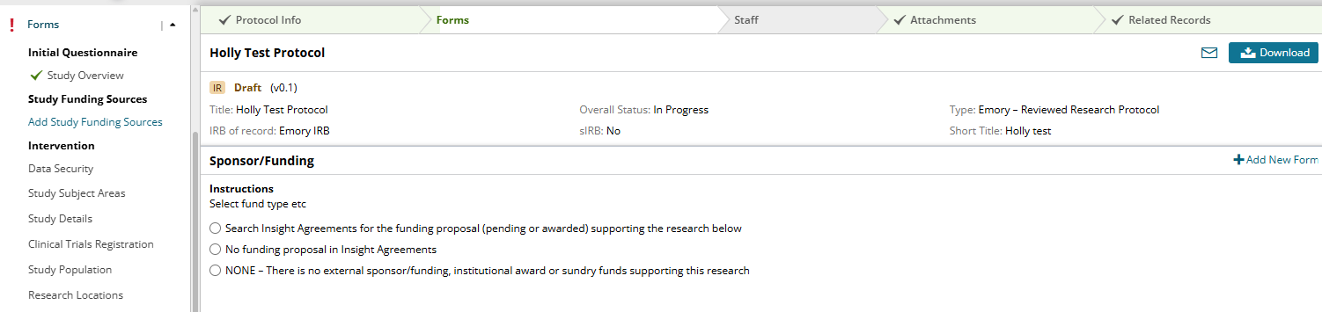
Making the Linkage between Humans and Agreements
*Insight is being modified to allow an Agreement to be selected while in “Development” status to allow for concurrent review of the contract and protocol.

Slide 11
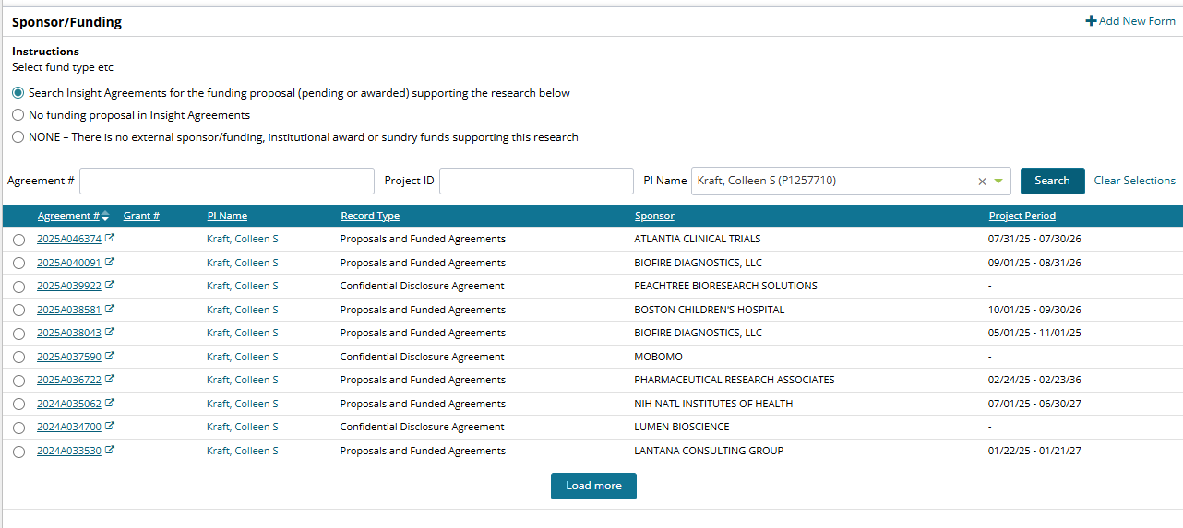
Making the Linkage between Humans and Agreements

Slide 12
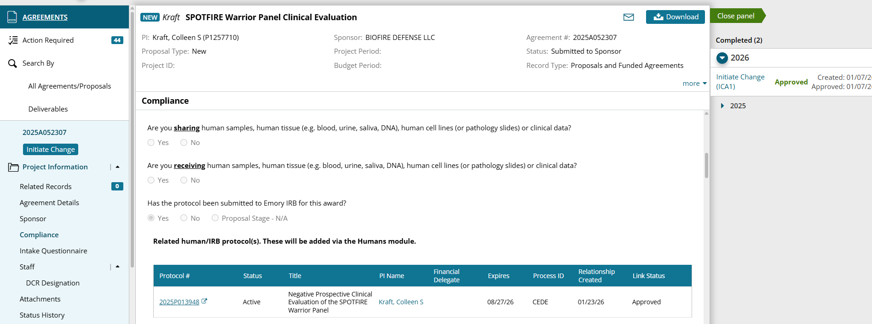
Making the Linkage between Humans and Agreements
Once a protocol is linked via the Humans module, it will be displayed as “read only” in Agreements.
Until the protocol is linked in Humans, nothing will show in Agreements:

Slide 13
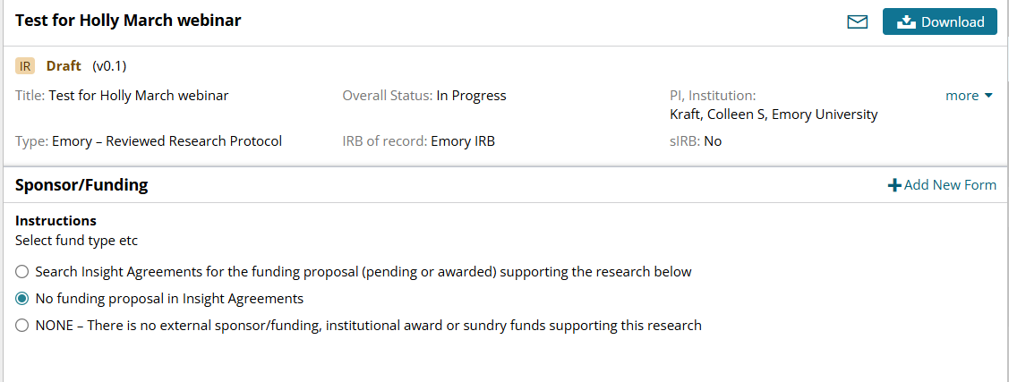
Making the Linkage between Humans and Agreements
There currently remains an option to indicate there is funding, but that there is no Agreement record. This should be rare. External funding should be routed as an Agreement in Insight.

Slide 14
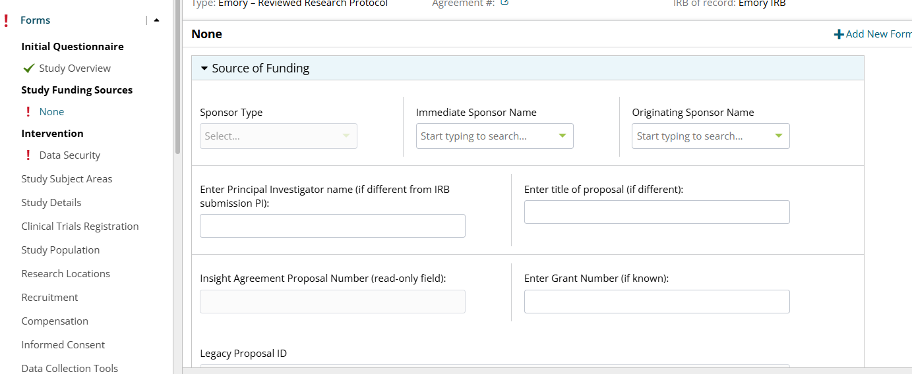
Making the Linkage between Humans and Agreements
Requires manual information of data that will be in the Agreements record.

Slide 15
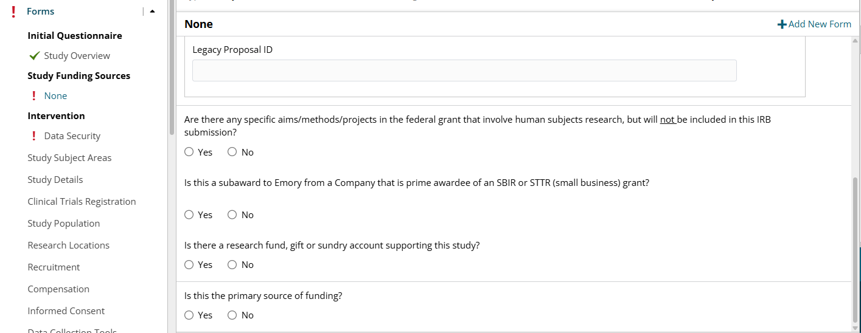
Making the Linkage between Humans and Agreements
Requires manual information of data that will be in the Agreements record.

Slide 16
Tips for Finding an Agreement to Link
  If a user entering a Humans protocol does not have the Agreement number and the information displayed in the Humans module is not sufficient to determine the exact agreement, users may search the Agreements module to identify the appropriate Agreement to link to the Humans module.

Slide 17
Tips for Finding an Agreement to Link
  Go to the Agreements module in Insight and select All Agreements/Proposals from the left menu.
  This will bring up a search feature:

Slide 18
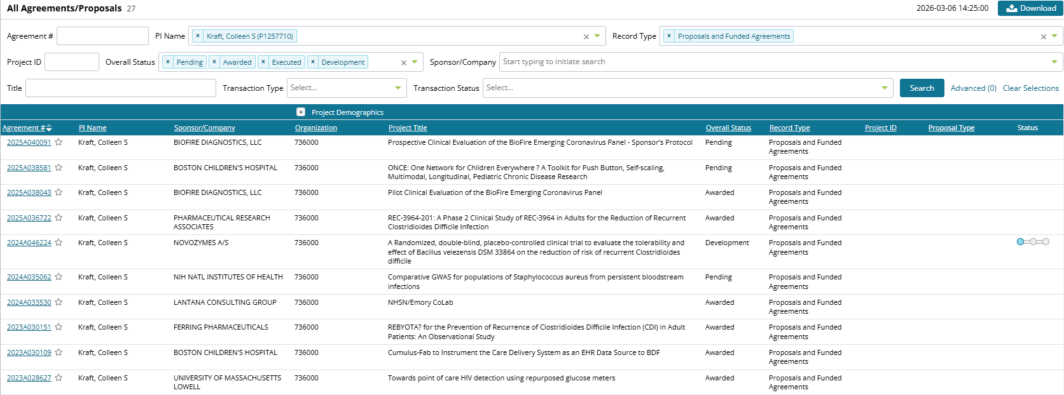
Tips for Finding an Agreement to Link
  Limit the search to Proposals and Funded Agreements record type. You can search by a variety of criteria, including PI name:
Notes:
More information displays than was displayed in the Humans module search feature. You may be able to identify the appropriate record based on this search.

Slide 19
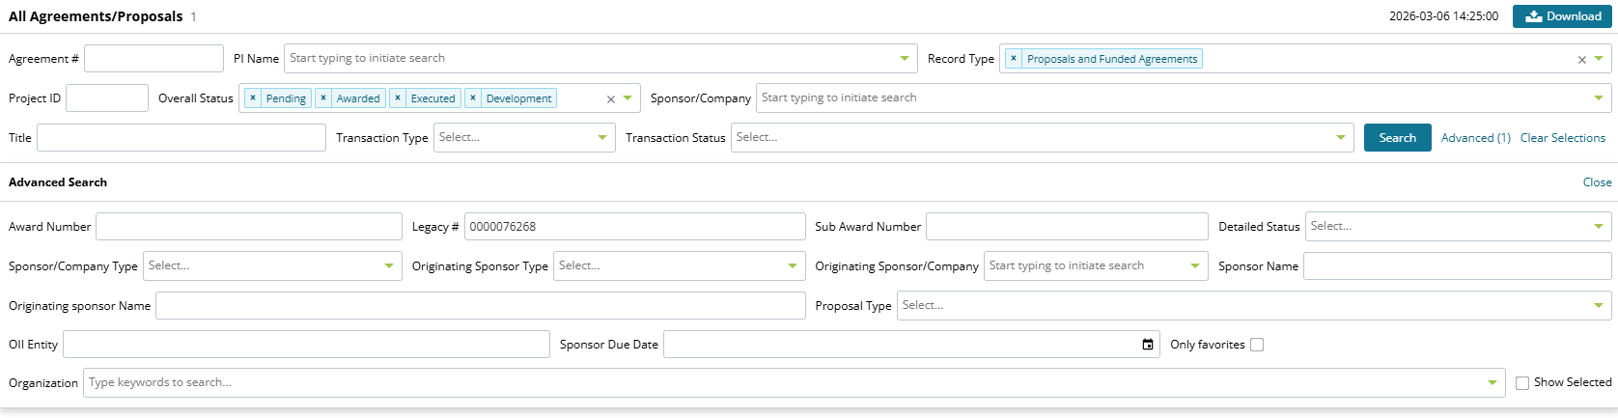
Tips for Finding an Agreement to Link
  Additional search criteria can be found by selecting the Advanced option. If you know the associated Compass/EPEX ID, enter it into the “Legacy ID” field.
Notes:
More information displays than was displayed in the Humans module search feature. You may be able to identify the appropriate record based on this search.

Slide 20
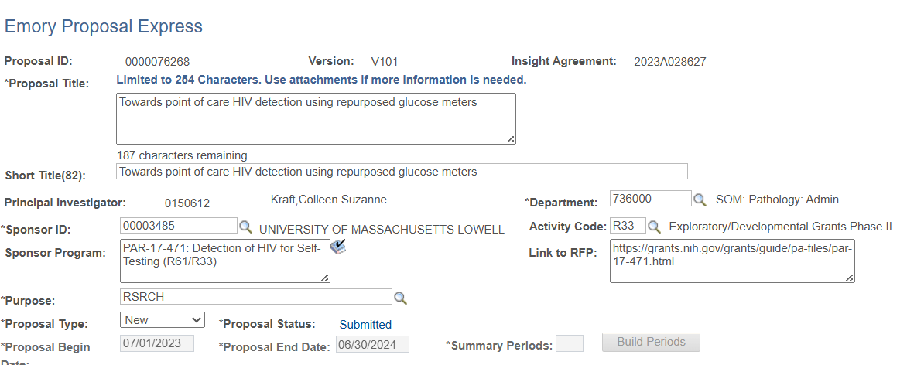
Tips for Finding an Agreement to Link
  The Agreements number is also visible in EPEX/Compass:

Slide 21
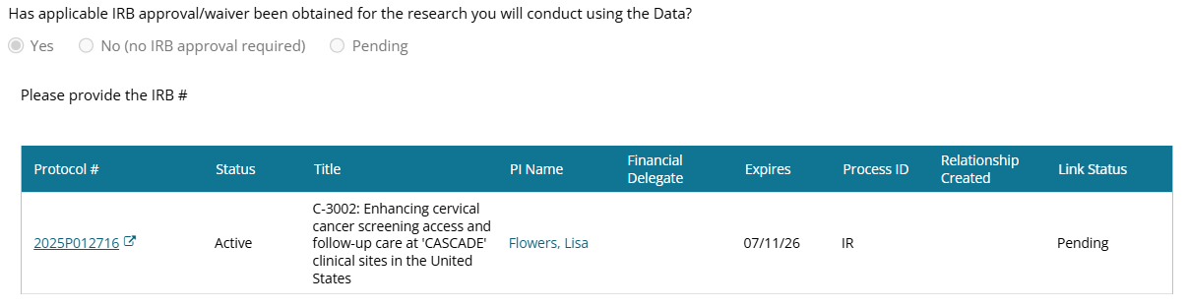
Linking Records in Other Agreement Types
  The user creating the record will identify the Humans protocol(s) associated with the Agreement.

Slide 22

QUESTIONS?

