Slide 1
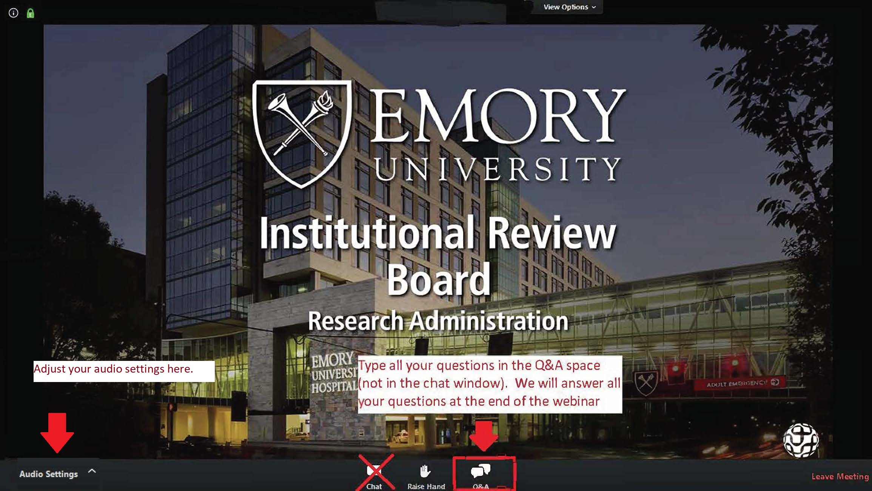
You can adjust your audio settings here.
Open and use the Q&A to ask questions.
We will answer questions at the end of the webinar presentation.

Slide 2
Institutional Review Board (IRB) Submission Guidance Overview and Tips
April 9, 2026

Slide 3

Today’s agenda
Where to Find Information on Website
Where to Find Help with Insight
Differences Between Insight and eIRB
Insight Submission Tips
Completing Forms
Pitfalls to Avoid that Cause Delays
What to do when you have questions

Slide 4
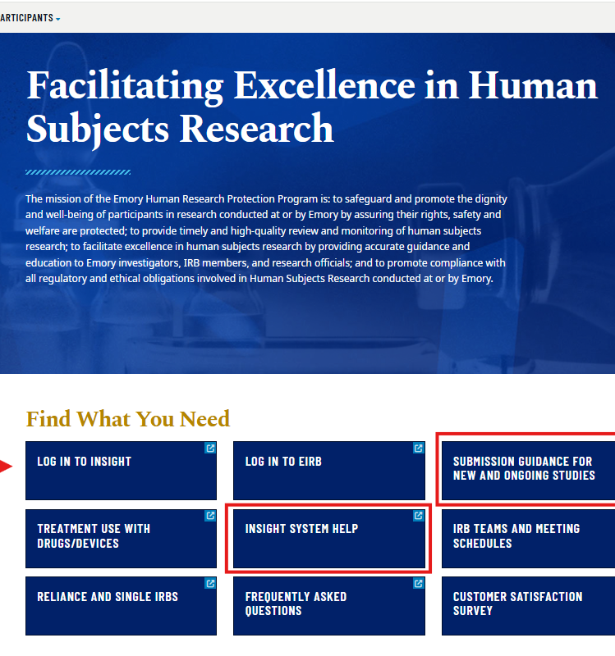
Where to find information on the IRB website
Link to the Emory IRB's home page
https://irb.emory.edu/

Slide 5
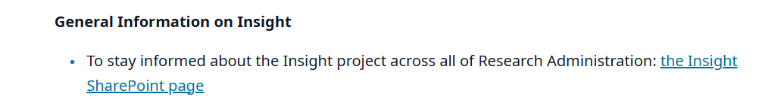
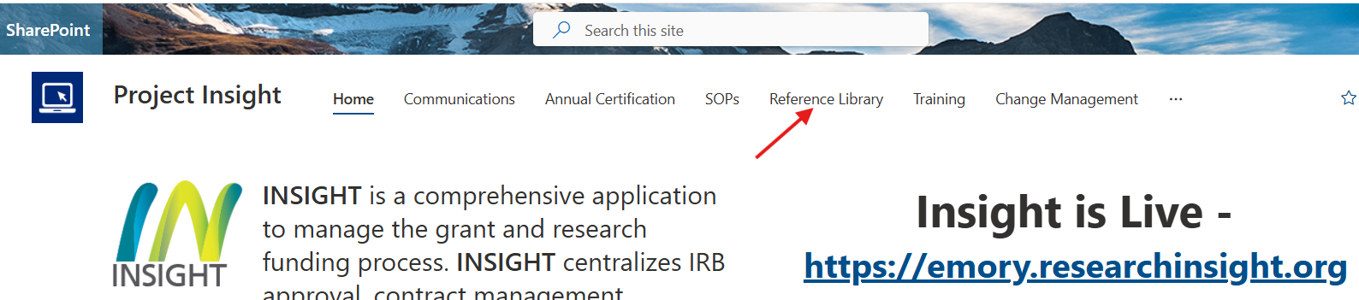
Insight system help

Slide 6
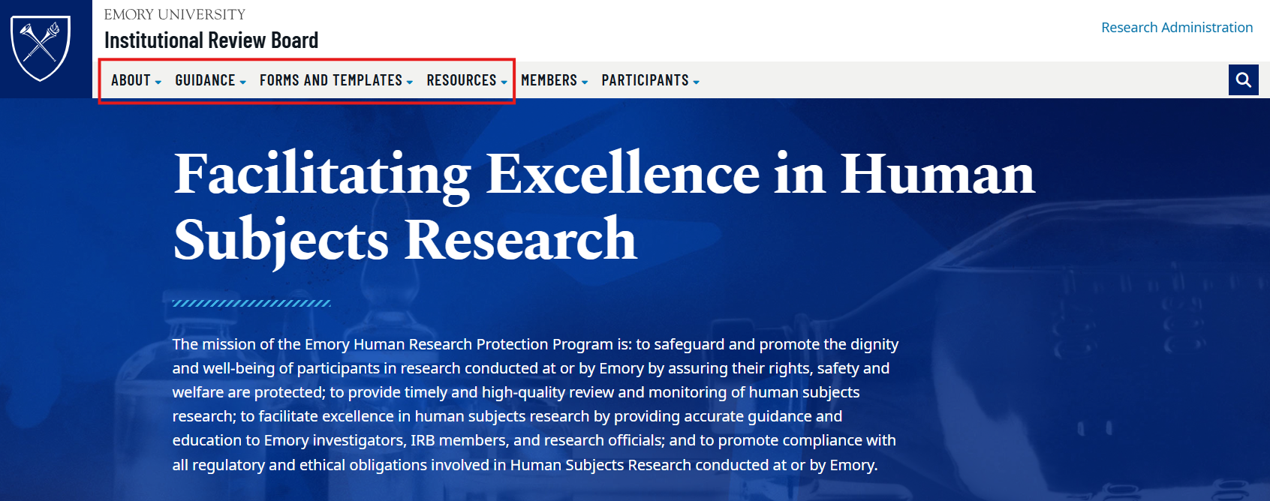
Where to find information on the IRB website (cont’d)

Slide 7
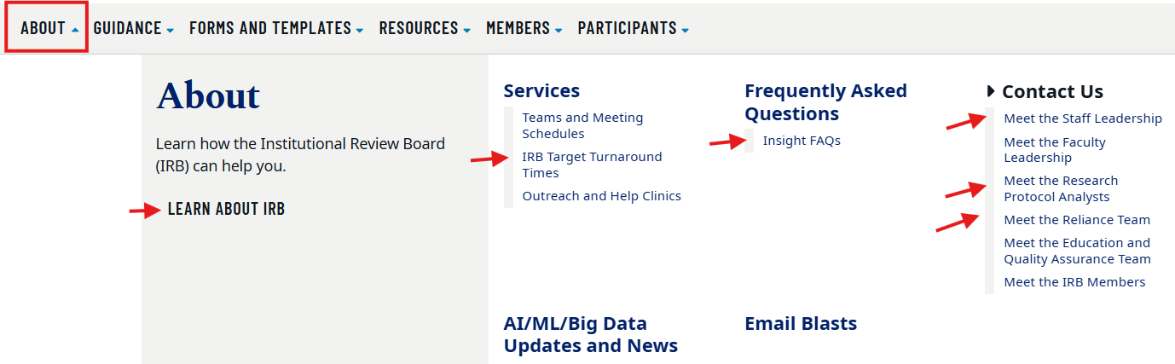
The “About” tab

Slide 8
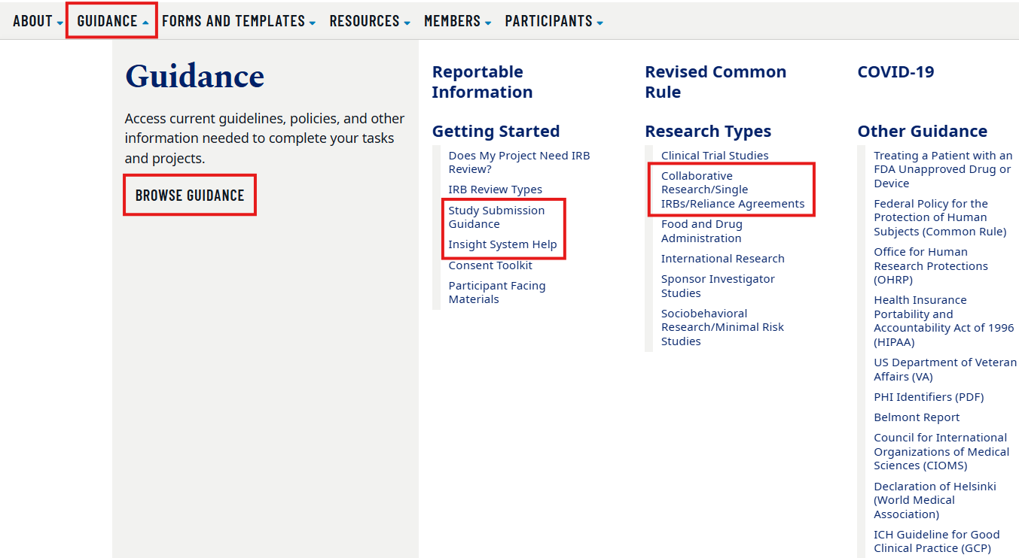
The “guidance” tab

Slide 9
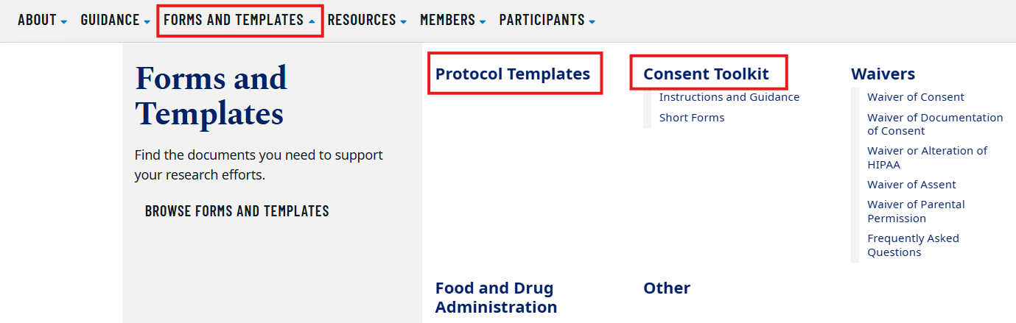
The “forms and templates” tab

Slide 10
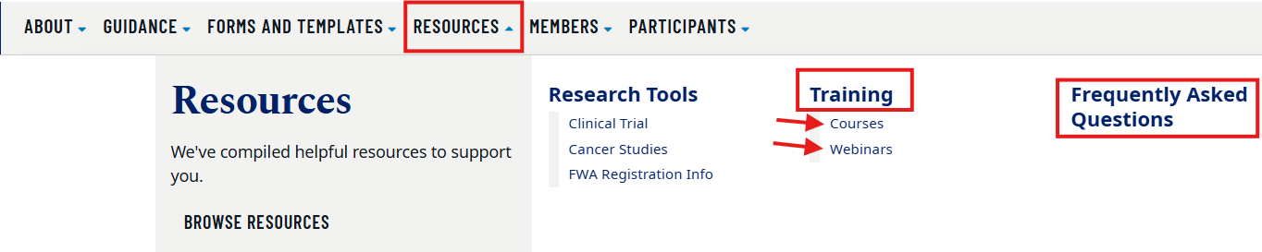
The “resources” tab

Slide 11
Where to find help with insight
Review Insight training materials: https://emory.sharepoint.com/sites/Insight/SitePages/Reference-Library.aspx
This reference library includes general training videos and job aids, and materials for Disclosures, Agreements and Humans.

Slide 12
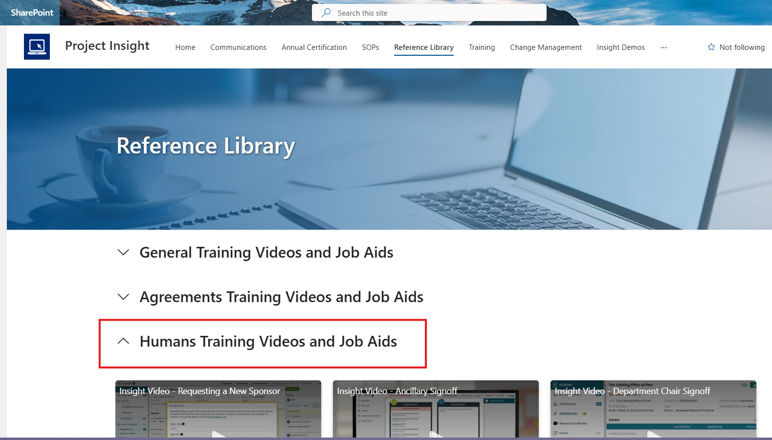
Click on Humans training videos and job aids

Slide 13
Videos
Replying to Comments
PI Signoff
Viewing Related Records
How to Search for a Protocol
Creating a Research Protocol
Viewing and Adding Attachments

Slide 14
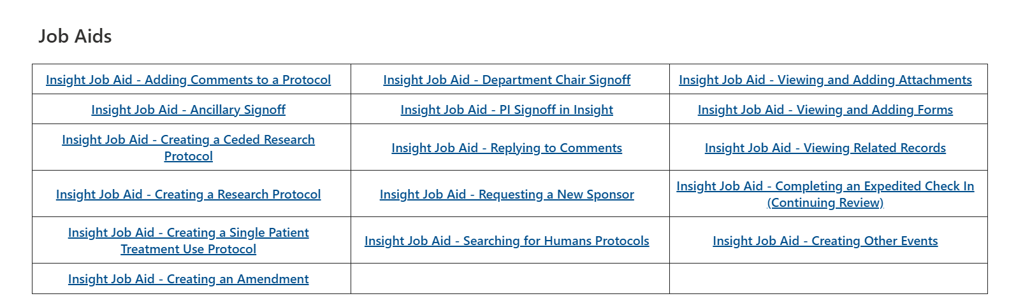
Job aids

Slide 15
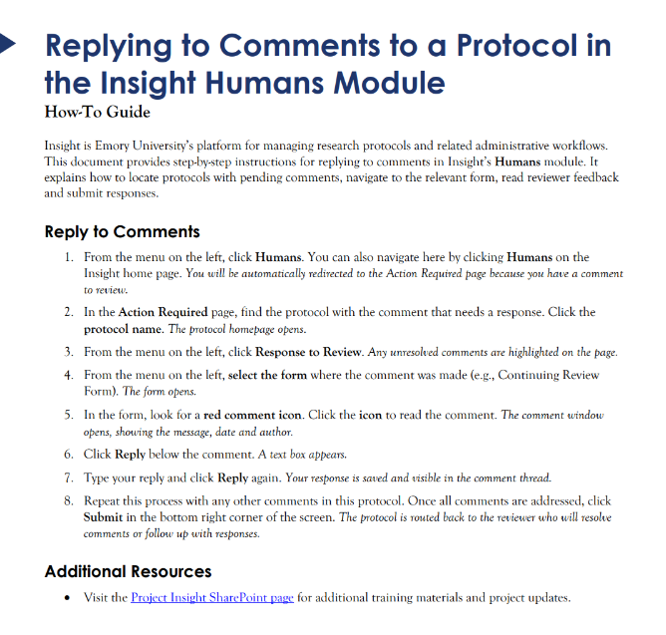
Job aid for replying to comments

Slide 16
How is insight different?
Ancillary Reviews – Automatically triggered based on Study Details form
No PI proxy role - the PI must submit everything
Study ID - not generated until the PI submits. This is no longer an issue.
Logged Comments – no mechanism to log comments to IRB analyst asking for updates or clarifications but study teams can respond to comments on forms.

Slide 17
How is insight different from eIRB? (cont’d)
CITI training is automatically checked
Staff updates only needed once a year (at CR)
An IRB analyst is not assigned to the study. All submissions assigned in round robin fashion to IRB staff.
Previously required documents used in eIRB no longer needed in Insight
  HIPAA Applicability & Waiver worksheet
  Detailed protocol for studies limited to:
    Secondary Data Analysis
    Chart reviews
    Exempt studies

Slide 18
Insight submission Tips
Confirm
Confirm Study Personnel CITI certification is current (Review requirements on website (Resources, CITI training, see table)
Use
Use current protocol & consent templates posted on website
Review
Review our submission guidance
Ensure
Ensure consent/protocol/Insight forms say same things

Slide 19
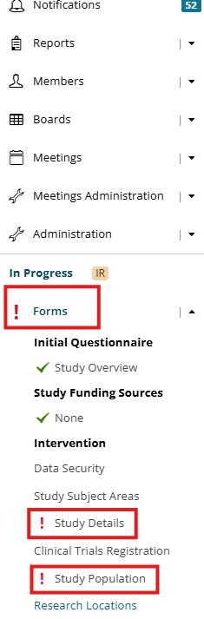
Completing the Insight forms
Respond to each question on each form that populates.
On left Panel, red exclamation marks indicate forms that need your attention. If one is red, you have not addressed each question in that form.

Slide 20
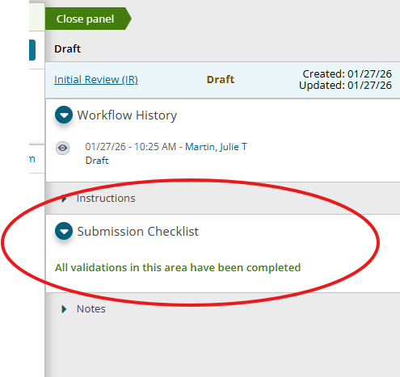
The Submission Checklist will show you what still needs to be done before you can submit. As forms are completed, they disappear.

Slide 21
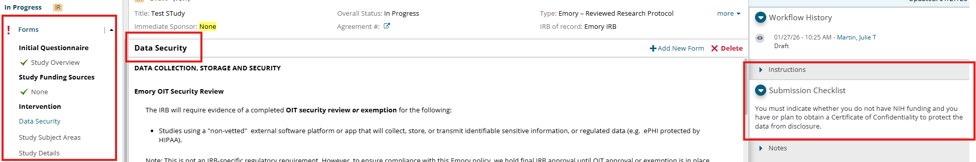
Red Exclamation ! = Action Required
Green Checkmark = Form is Complete

Slide 22
Avoid these pitfalls that cause delays:
not using current consent form & protocol templates
removing/altering template language in those documents
submitting conflicting information to the IRB (# enrolled, time in study, procedures, risks, compensation, etc.)
not being clear regarding research specific procedures and those being done regardless of whether participant joins study (research vs. usual care)
adding grant/collaborators to existing studies for SDA which requires a separate IRB submission
Adding staff using the External Staff option. Please do not use this. We use an external team member list instead and you will need to reach out to the reliance team before adding external collaborators.

Slide 23
What to do when you have questions
Review guidance on our website: https://irb.emory.edu/
Review Insight training materials: https://emory.sharepoint.com/sites/Insight/SitePages/Reference-Library.aspx
If your question is about an existing submission, email the analyst screening it. You can see the analyst name on the right column (expedited screener or full board screener). You can find contact information on our Contact Us page. Please refrain from contacting the reviewer since they are busy faculty. Contact the IRB instead. https://irb.emory.edu/about/contact/index.html
If your question is about a future IRB submission or a general question, email our listserv at IRB@emory.edu.
If your question is about reliance, email the reliance team at irb.reliance@emory.edu.

Slide 24
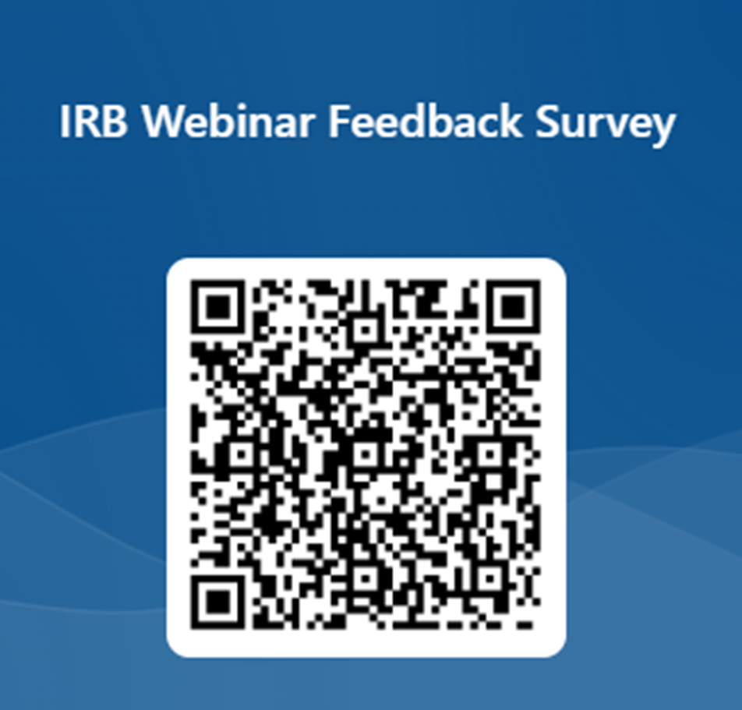
Questions? Comments?
Please let us know what you think of this webinar!

