Slide 1
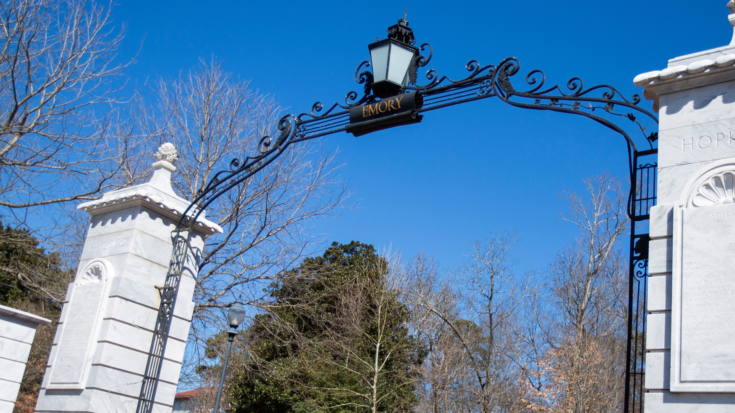

Conflict of Interest Overview
Aric Edwards, Director
COI
Jan. 8, 2025

Slide 2


The Team!
Angela Toole, Assistant Director
Jelve Gozly, Senior COI Specialist
Adrianne Brutscher, COI Specialist
Notes:
Dave

Slide 3
What does the COI Office Do?
Review for Research Conflicts
Convene Research COI Committee
Institutional Conflict of Interest
Organizational Conflict of Interest
Partner with schools and departments
We help!
Notes:
Dave

Slide 4
Importance of Disclosure:
Ensure compliance and adherence to regulations!
Ethics of Transparency
Good Science requires objectivity
Avoiding Legal Issues
Notes:
Dave

Slide 5
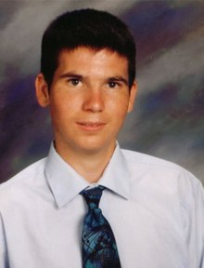
Why Conflicts Matter:
Jesse Gelsinger's Death
Financial Stakes contributed to his death
Testing should have led to his exclusion from the trial
Inappropriate disclosure of drug's effects
Behavior towards others
Conflicts often lead to interpersonal conflicts
Inability to objectively engage with peers and subordinates
Misuse of home institute's resources
Notes:
Dave

Slide 6








Mission: Ensure Research Objectivity
Design, conduct, and reporting of research must be objective
Multifaceted relationships between Emory Investigators and industry exist and often complement research
Must follow federal rules
as stewards of federal money
Primary commitment of time and intellectual energy owed to Emory by employees
Notes:
Aric

Slide 7

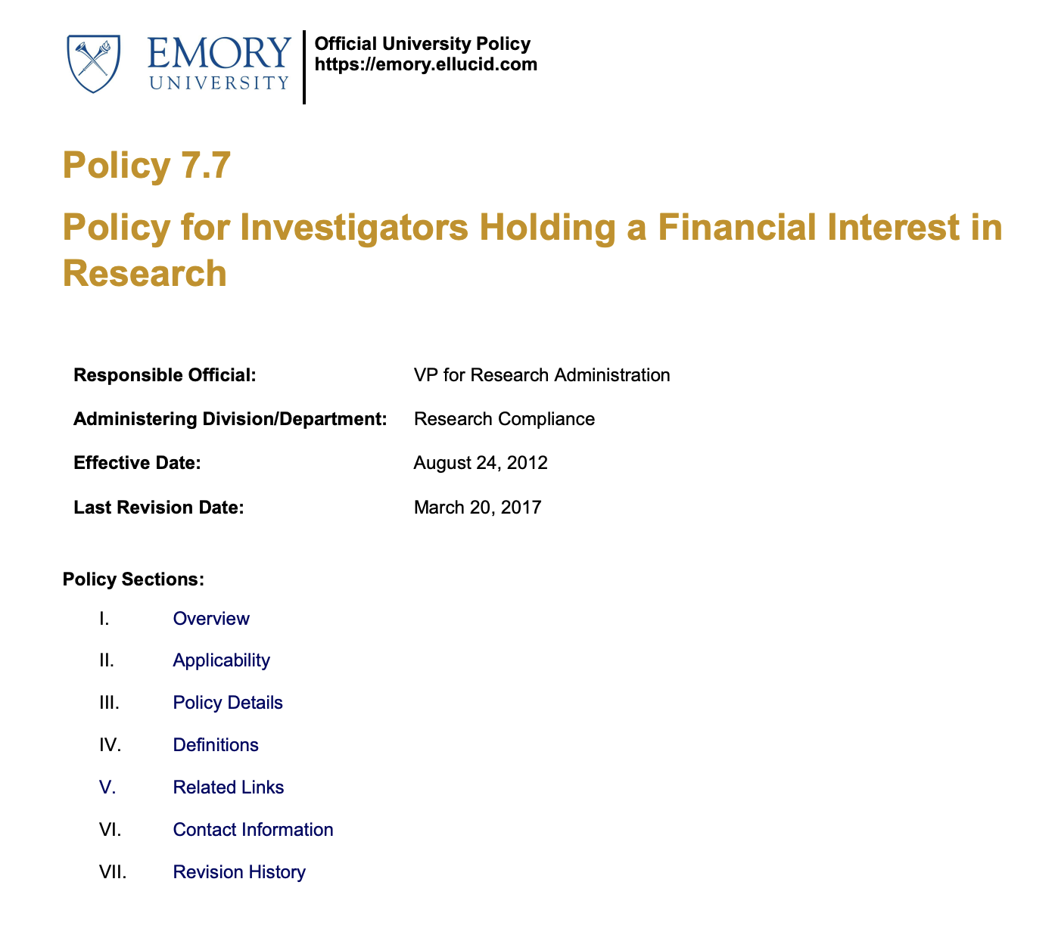

What is a Financial Conflict of Interest?
Determination that an individual’s financial interest could significantly alter the design, conduct, or reporting of research
Notes:
Dave

Slide 8




Policy 7.7 Requirements
Who:
Investigators & Key Personnel
What:
Disclose Significant Financial Interests
When: Within 30 days of hire, within 30 days of receiving new SFI, annually, with sponsored awards
Where:
Emory’s electronic disclosure system
Notes:
Dave

Slide 9
Disclosure Obligations:
Individuals have an obligation to avoid conflicts of interest and commitment when carrying out their external/outside interest/activities (submission of a Pre-Approval Request)
All external relationships, domestic and international, should be transparent and disclosed in a manner consistent with applicable requirements, including federal and state laws/regulations/agency guidance and Emory University’s own policies and procedures.
Notes:
Dave

Slide 10
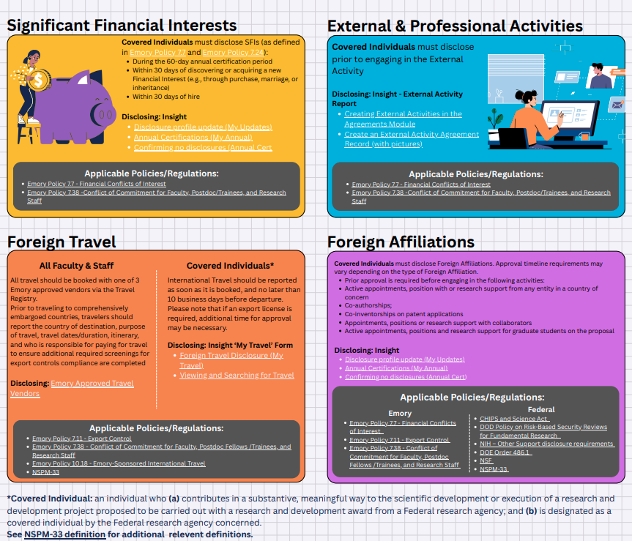
Disclosure Requirements:
https://rcra.emory.edu/_includes/documents/sections/coi/international-disclosure-matrix-1.pdf

Slide 11
Annual Certification = Confirmation of Outside Activities:
Individuals at Emory University are expected to report (i.e., disclose) any outside activities, relationships, or interest ("outside activity") with an external entity (e.g., company, organization, etc.) to Emory COI/COC Office for a conflict of interest (COI) review prior to beginning the activity.
Examples include:
Consulting for a company, serving as an expert witness, founding a new start-up company
Notes:
Aric

Slide 12
Annual Disclosure/Certification Process:
An email notification from to complete the Annual Certification
Review and update any previously reported outside interests
Disclosing any new outside interests
Notes:
Aric

Slide 13
Completion Requirements:
Faculty/staff (may include adjunct faculty and emeritus faculty
Postdoctoral scholars
Research personnel engaged in designing, conducting, or reporting sponsored research (including part-time and temporary employees).
Notes:
Aric

Slide 14
Resources and Reminders:
COI/COC Webpages
SharePoint page on Annual Certification
COI/COC Virtual Office Hours on Tuesday and Thursday 10 am-11 am link on SharePoint Annual Certification Page
The annual certification cycle is from December 1, 2025-February 28, 2026
Disclosure Requirements:
  Within 30 days of onboarding to Emory University
  Within 30 days of discovery or acquiring a new significant financial interest (SFI)
Notes:
Rose/Dave

Slide 15

Important Dates:
The FY 25 Annual Certification Cycle is December 1, 2025-February 28, 2026.
1

Slide 16
Questions?
Contact: aric.Edwards@emory.edu

